Slide 1
Working Together for a More Secure Ecosystem

Slide 2
Open source is everywhere
96%
of codebases
77%
of code within
70–90%
of all software
Source: Synopsis
Source: Linux Foundation
https://www.synopsys.com/software-integrity/resources/analyst-reports/open-source-security-risk-analysis.html
https://www.linuxfoundation.org/blog/blog/a-summary-of-census-ii-open-source-software-application-libraries-the-world-depends-on
Notes:
According to the Linux Foundation in 2022, 70-90% of any given software is made up of open source components.
The Synopsys 2023 report showed
We won. Now what?

Slide 3

Open Source Security Foundation (OpenSSF)
Software developers, security engineers, and more working together to secure open source software for the greater public good.

Slide 4
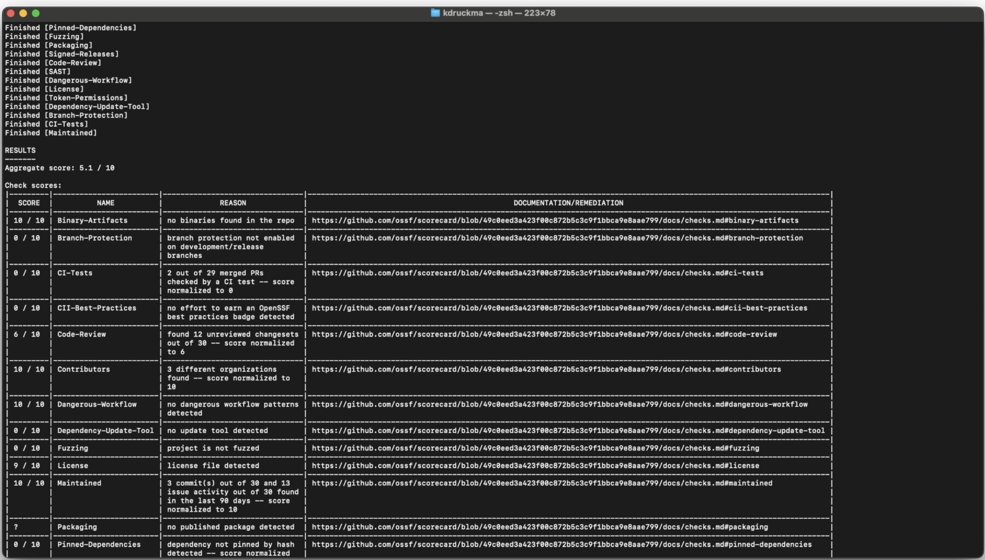
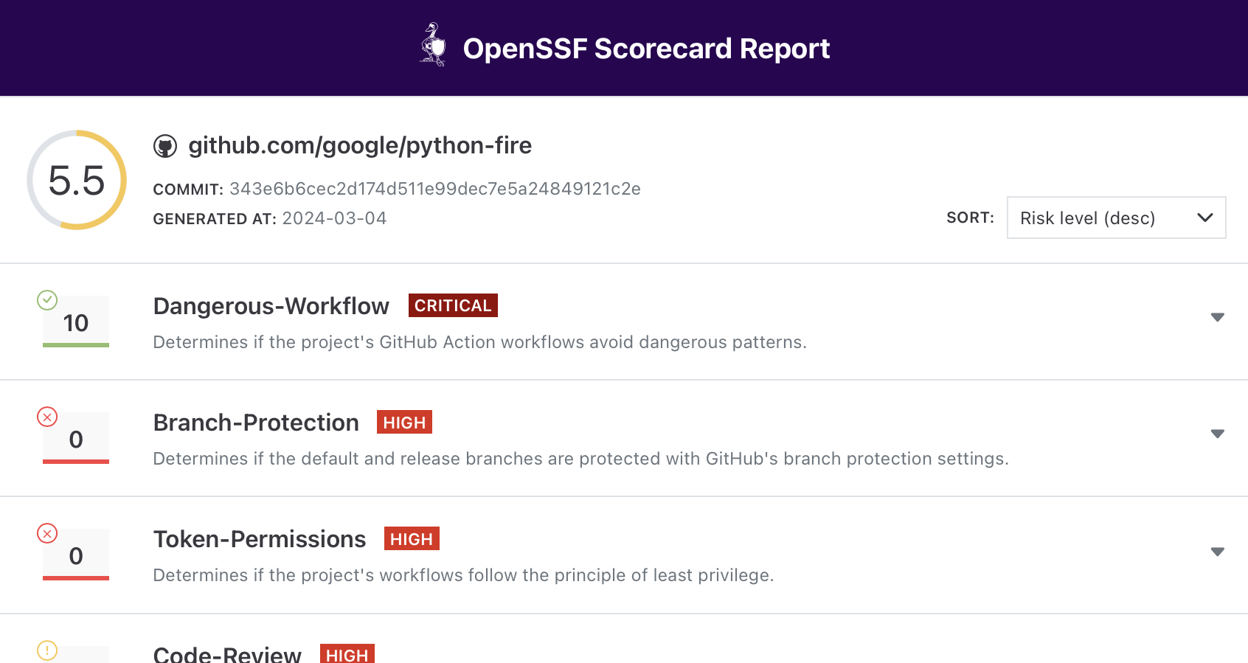
OpenSSF Scorecard
OpenSSF projects and tools
Automated checks for best practices that provide quick, easy project assessment
Score in terminal …
… or via browser

Slide 5
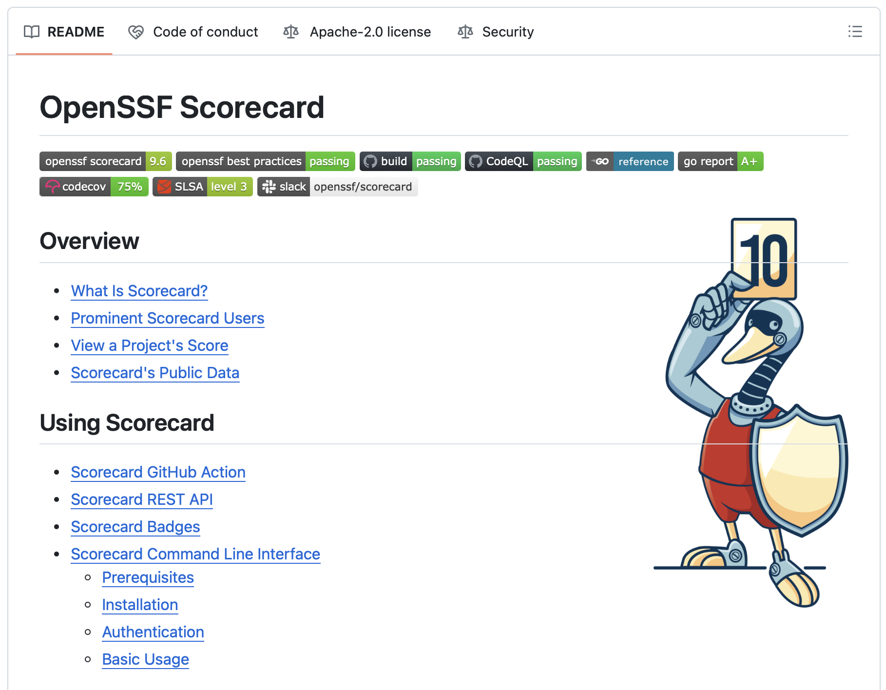
OpenSSF Scorecard
OpenSSF projects and tools
Helps protect against
Malicious maintainers and packages
Poorly maintained projects
Compromised build systems and/or code

Slide 6
Secure Supply Chain Consumption Framework (S2C2F)
OpenSSF projects and tools
Framework for securely consuming open source software (OSS) dependencies.
The S2C2F framework progression
Minimum OSS Governance Program
Use package managers
Local copy of artifact
Scan with known vulnerabilities
Scan for software licenses
Inventory OSS
Manual OSS updates
Secure Consumption and Improved MTTR
Scan for end life
Have an incident response plan
Auto OSS updates
Alert on vulnerabilities at PR time
Audit that consumption is through the approved ingestion method
Validate integrity of OSS
Secure package source file configuration
Malware Defense and Zero-Day Detection
Deny list capability
Clone OSS source
Scan for malware
Proactive security reviews
Enforce OSS provenance
Enforce consumption from curated feed
Advanced Threat Defense
Validate the SBOMs of OSS consumed
Rebuild OSS on trusted infrastructure
Digitally sign rebuilt OSS
Generate SBOM for rebuilt OSS
Digitally sign protected SBOMs
Implement fixes
https://github.com/ossf/s2c2f/blob/main/specification/Secure_Supply_Chain_Consumption_Framework_(S2C2F).pdf
Notes:
Grouped by maturity level, and your target will vary according to your needs.
Mentioned also because the spec itself includes a list of free tools that you can use to improve your security posture.

Slide 7

SLSA
OpenSSF projects and tools
Supply-chain Levels for Software Artifacts (SLSA) AKA ”Salsa"
Salsa is how you get from "safe enough" to being as resilient as possible, at any link in the chain.
Salsa is a security framework with a checklist of standards and controls that help prevent tampering, improve integrity, and secure packages and infrastructure.

Slide 8

GUAC
OpenSSF projects and tools
Graph for Understanding Artifact Composition (GUAC)
GUAC ingests software metadata—like SBOMs—and maps out relationships between software so you can fully understand your software security position and act as needed.

Slide 9

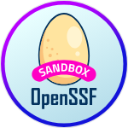
Protobom
OpenSSF projects and tools
Protobom
A Software Bill of Materials (SBOM) inventories the components within software and describes the supply chain relationships between them.
SBOMs are crucial for analyzing vulnerabilities and managing cybersecurity risks. Unfortunately, multiple SBOM data formats and identification schemes make wide adoption difficult.
Protobom creates a format-neutral data layer that lets applications work seamlessly with any kind of SBOM.
With Protobom, anyone can use SBOMs to improve their software supply chain risk management.

Slide 10
Get involved in the OpenSSF
Be your own hero!
openssf.org
The best way to influence an OSS project direction is to get involved.

Slide 11
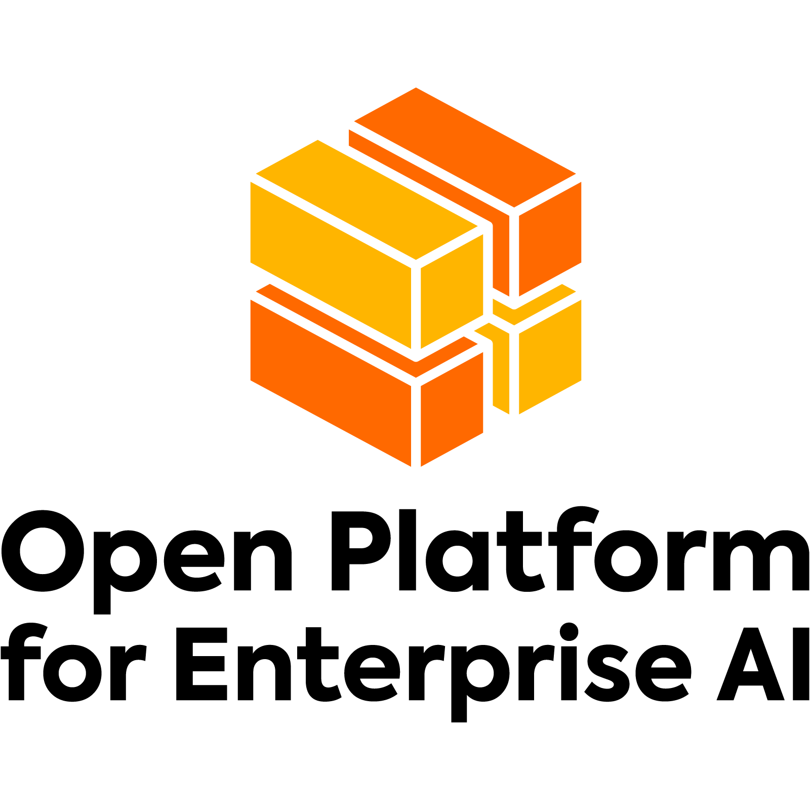
Open Platform for Enterprise AI (OPEA)
OPEA streamlines enterprise-grade generative AI with composable building blocks for LLMs, data stores, and prompt engines.
OPEA includes end-to-end workflows retrieval-augmented generation (RAG) for text, code, and image generating models.
A four-step assessment service grades AI performance, features, trustworthiness and enterprise-grade readiness.
OPEA.dev

Slide 12
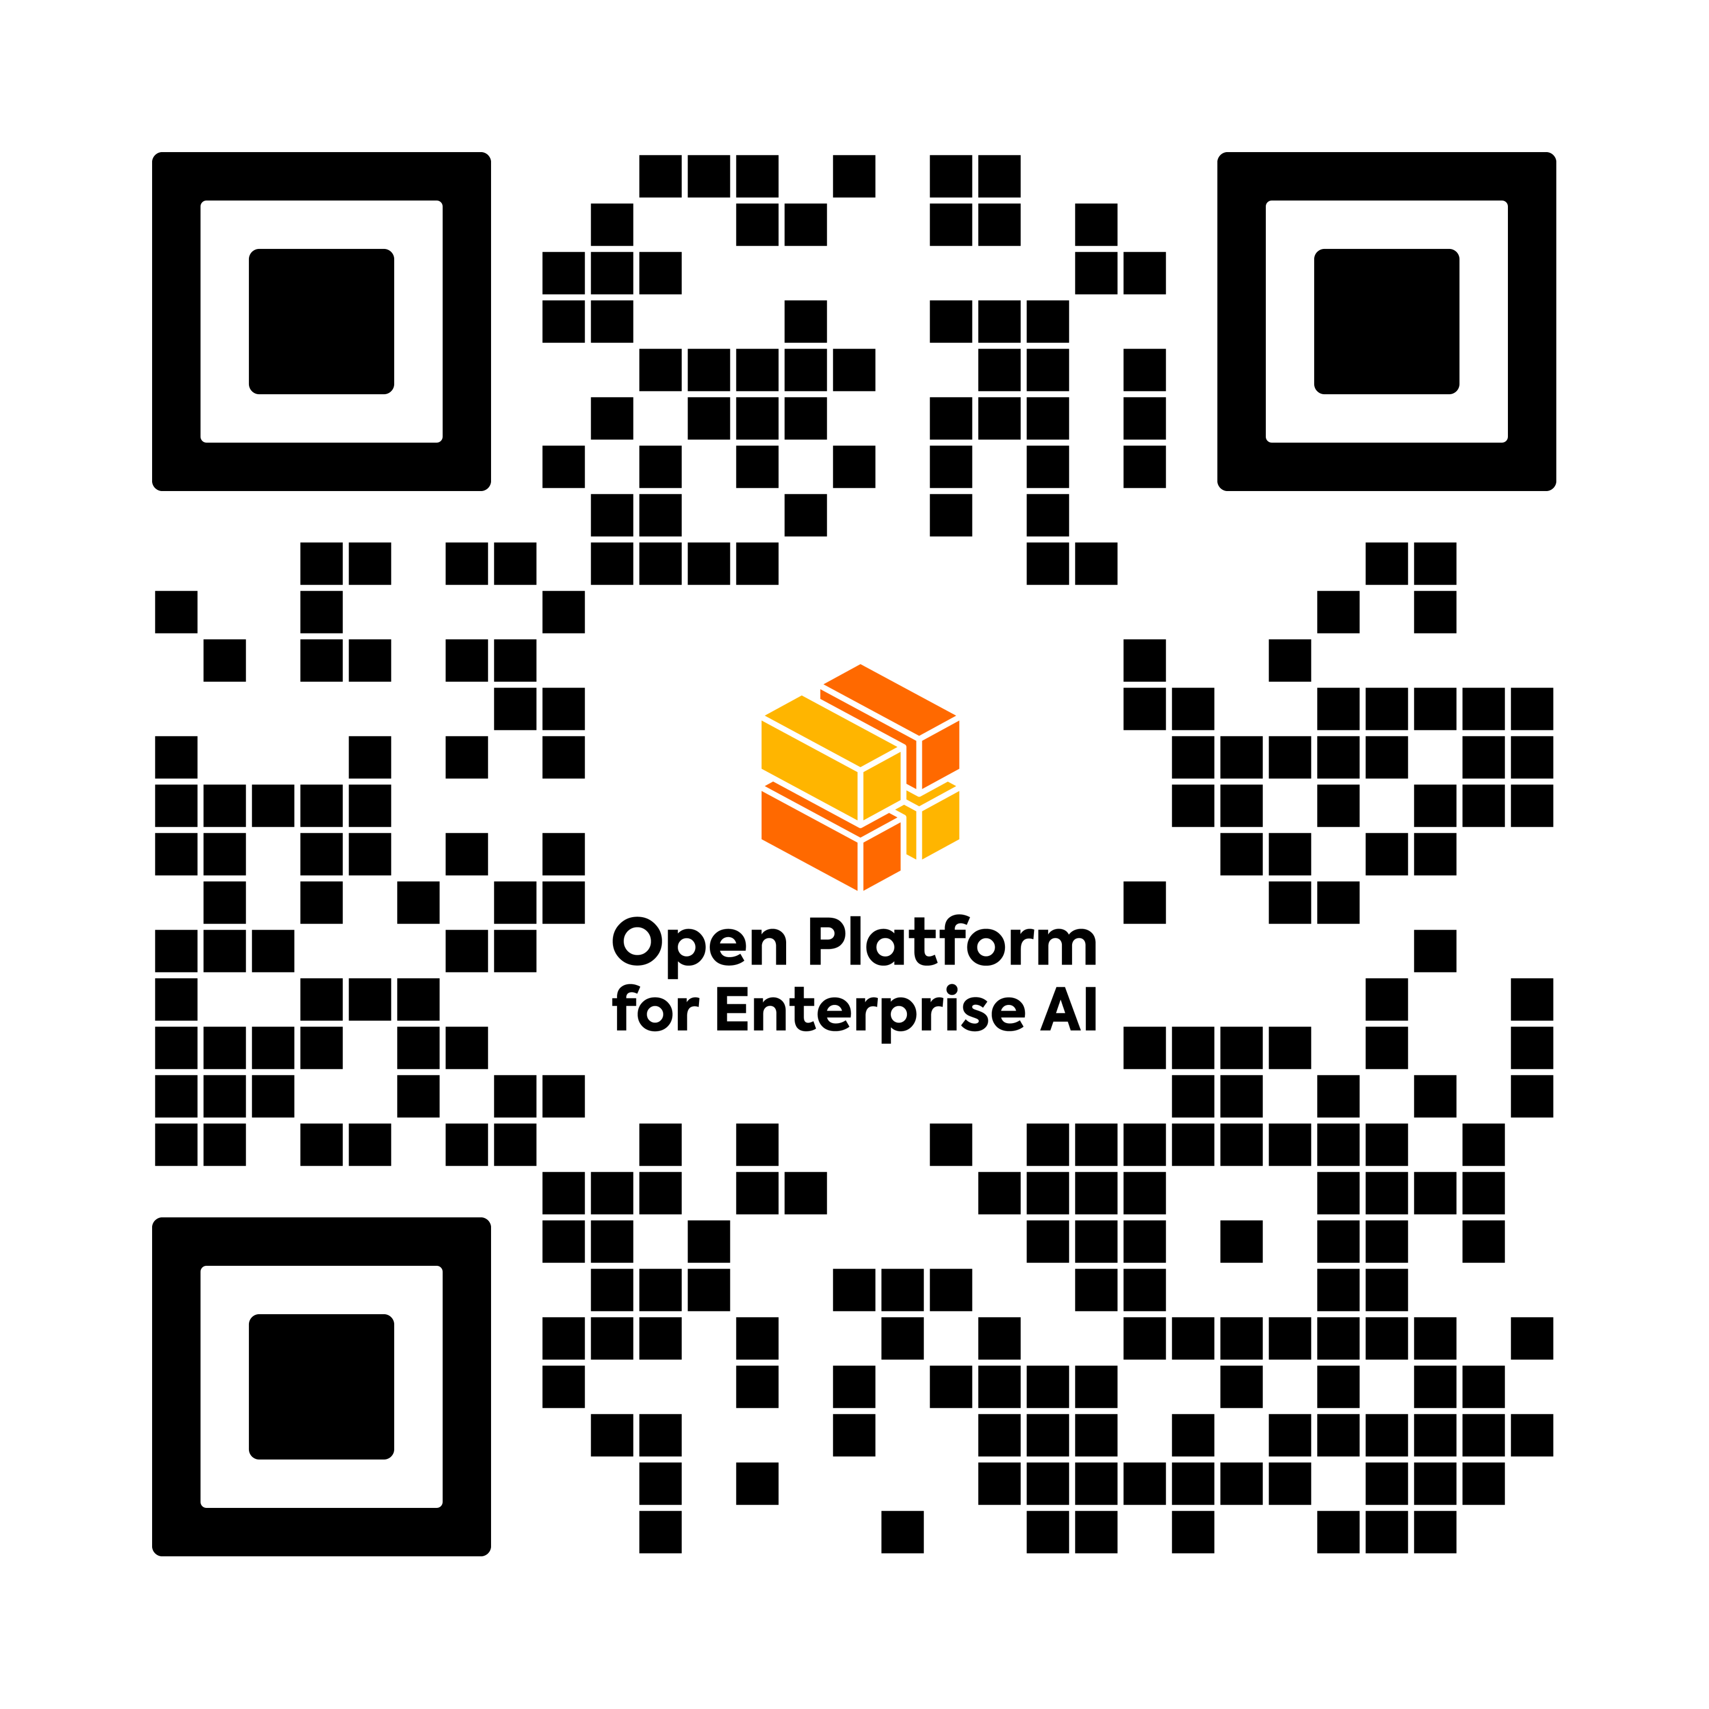
Get involved in OPEA!
Join the Security Working Group!

Slide 13
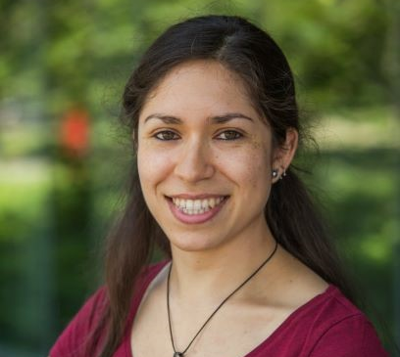




Open source needs you!
Join the Intel contributors making open source safer and more secure
Marcela Melara
Technical Advisory Council Chair Open Source Security Foundation (OpenSSF)
Dan Middleton
Technical Advisory Council Chair, Confidential Computing Consortium, OPEA Security WG
Arun Gupta Governing Board Chair, OpenSSF
Christopher “CRob” Robinson Technical Advisory Council Chair Open Source Security Foundation (OpenSSF)
Katherine Druckman
Marketing and DevRel Co-Chair, Open Source Security Foundation (OpenSSF), OPEA Security WG
*This is not a complete list

Slide 14

Where to find me
LinkedIn: katherinedruckman
GitHub: kdruckman
Twitter/X: @katherined
Fediverse: @katherined@reality2.social

Slide 15


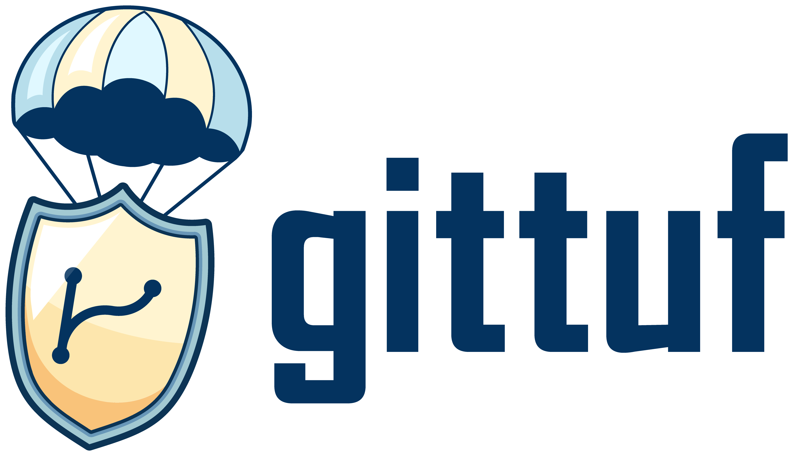


Join us on these open source projects
Original Catalysis layout
Client requested the type on the logo line up with the labels on the top row (OpenSSF, Scorecard, etc).
OpenSSF
Scorecard
SLSA
Protobom
Bomctl

Slide 16
Join us on these open source projects
Option 1
Top of logo type aligned with top stroke on text boxes
OpenSSF
Scorecard
SLSA
Protobom
Bomctl

Slide 17
Join us on these open source projects
Option 2
Top of logo type centered with type inside text boxes.
OpenSSF
Scorecard
SLSA
Protobom
Bomctl

Slide 18
Join us on these open source projects
Option 3
Baseline of logo type aligned with baseline of type inside text boxes.
OpenSSF
Scorecard
SLSA
Protobom
Bomctl

Slide 19
Join us on these open source projects
Option 4
Baseline of logo type aligned with top of strokes on text boxes.
OpenSSF
Scorecard
SLSA
Protobom
Bomctl

Slide 21
Parking lot
Deleted slides

Slide 22

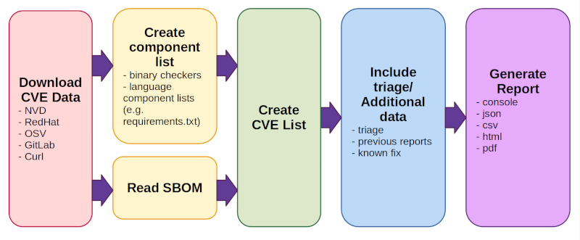
CVE-bin-tool
The CVE Binary Tool can help you find known vulnerabilities in software by using data from the National Vulnerability Database (NVD) list of Common Vulnerabilities and Exposures (CVEs) as well as known vulnerability data from Redhat, Open Source Vulnerability Database (OSV), Gitlab Advisory Database (GAD), and Curl.
A binary scanner—Helps you determine which packages may have been included as part of a piece of software.
Tools for scanning known component lists—Such as CSV files, SBOM formats, etc.
As simple as …
pip install cve-bin-tool
cve-bin-tool <directory/file>
https://github.com/intel/cve-bin-tool
Notes:
Maintained by the lovely Terri Oda at Intel, and others + Google summer of code students
A binary scanner - helps you determine which packages may have been included as part of a piece of software. There are 290 checkers which focus on common, vulnerable open source components such as openssl, libpng, libxml2 and expat.
Tools for scanning known component lists in various formats, including .csv, several linux distribution package lists, language specific package scanners and several Software Bill of Materials (SBOM) formats.

Slide 23
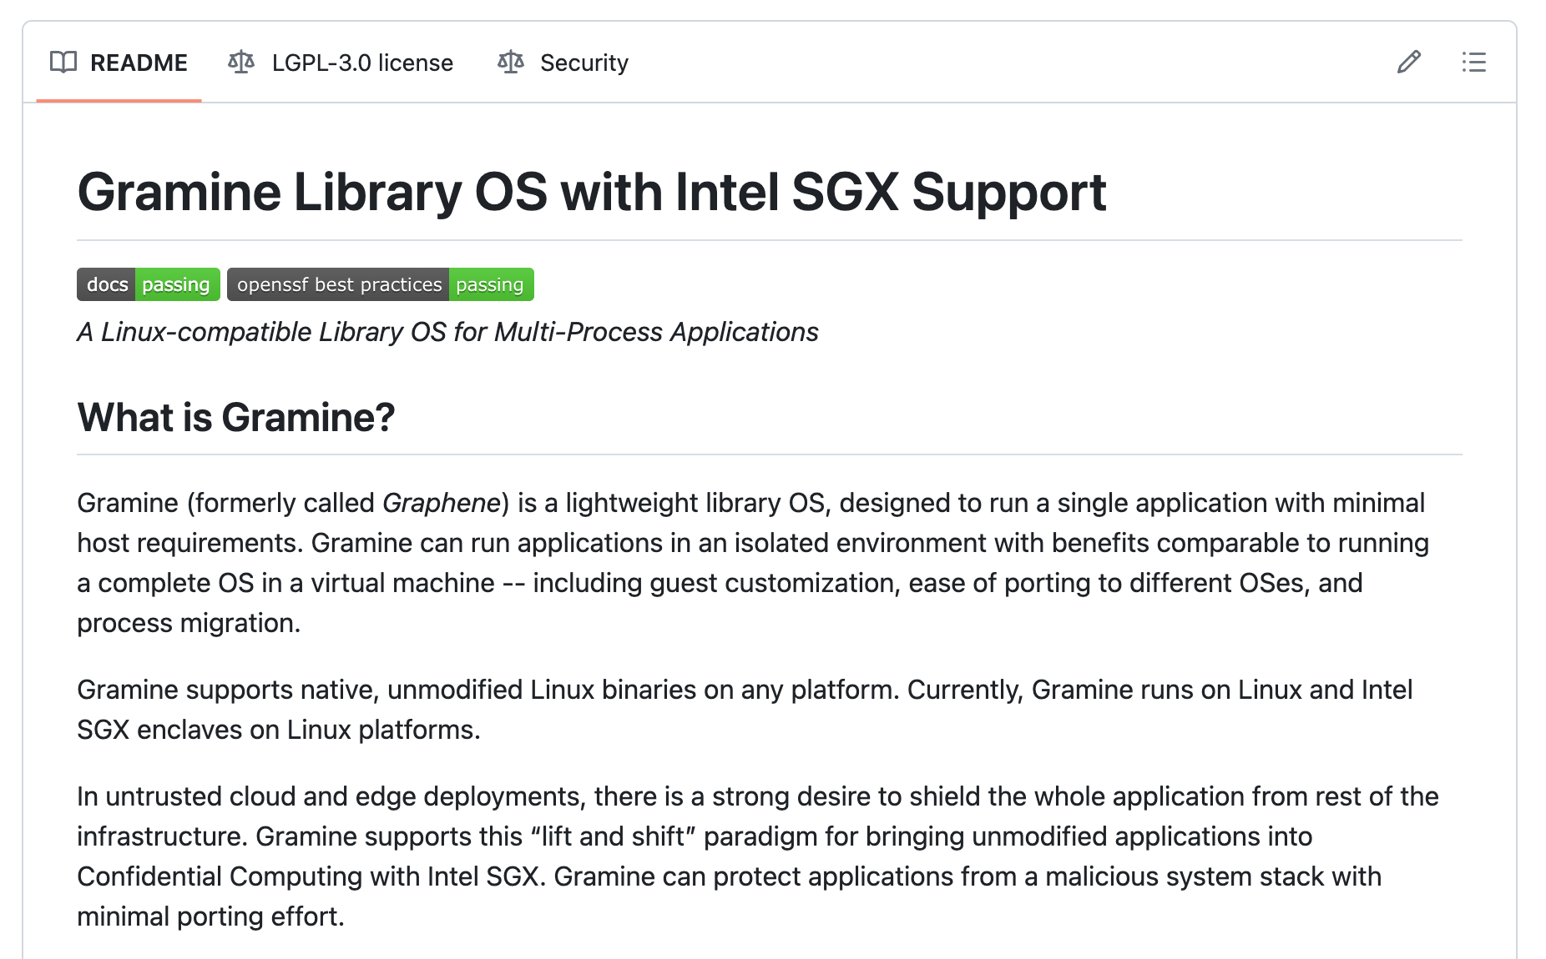
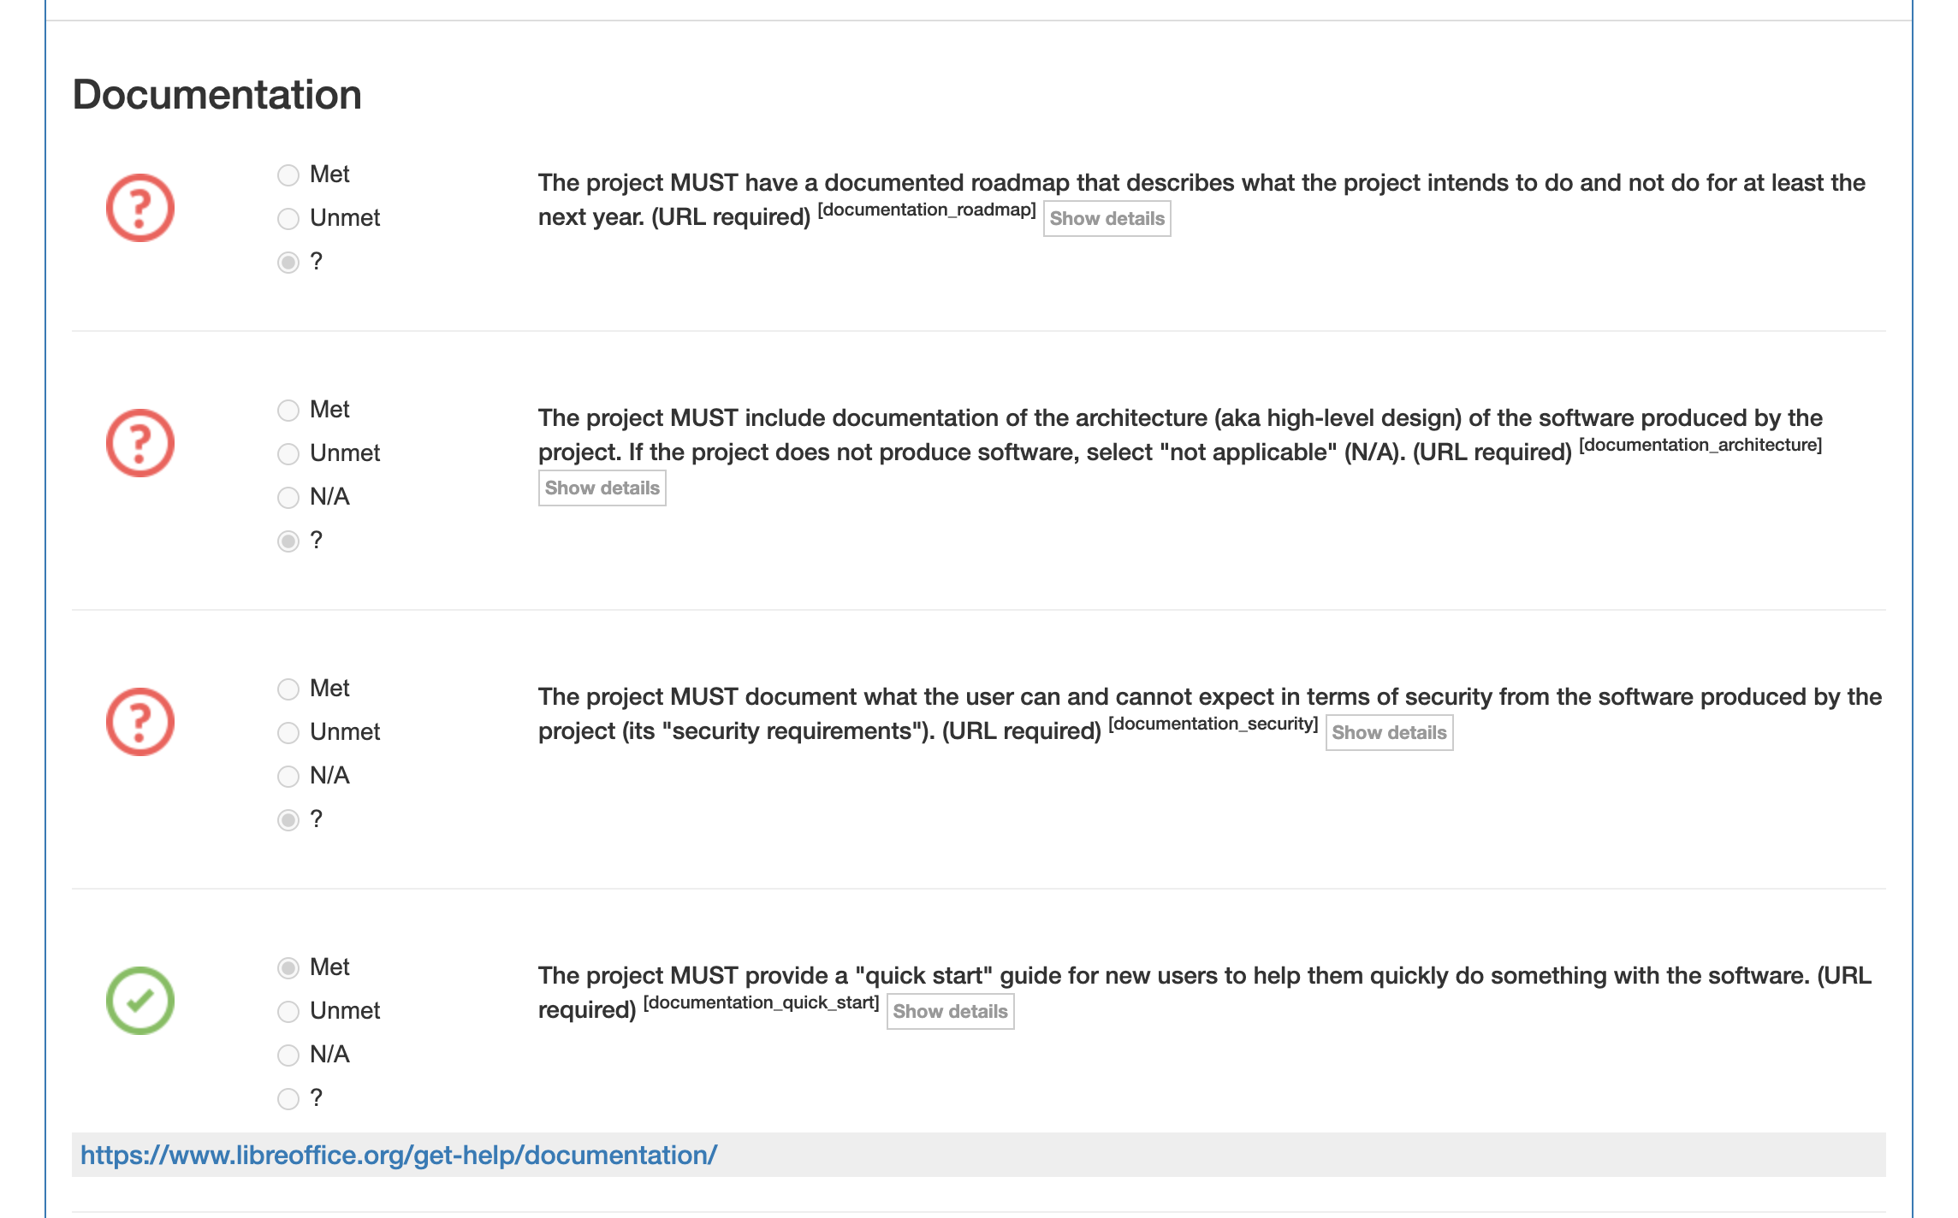
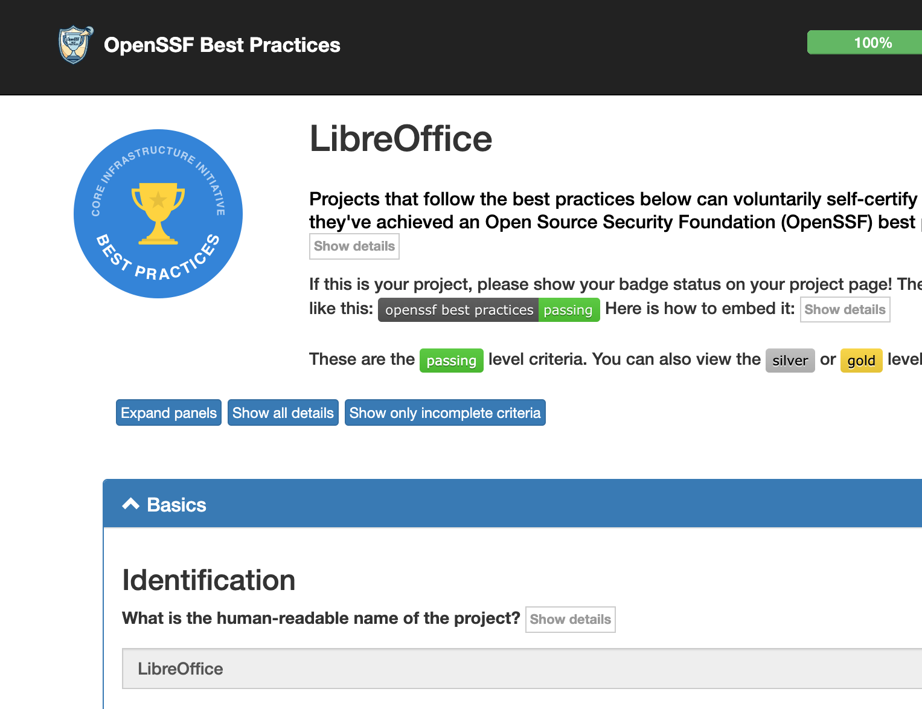
OpenSSF Best Practices Badge
OpenSSF projects and tools
https://www.bestpractices.dev/
Notes:
Security is never something that is over or done, but a process of building confidence in the integrity of our software. All these things help to build that confidence.
Various levels of best practices.

